Slide 1
Tech Ecommerce Performance Analysis
Collin Maccabe

Slide 2
Exploratory Questions
Which months had the best sales performance?
What is the percentage of orders cancelled?
How many completed orders had add-ons?
Which product SKU’s are performing the best?

Slide 3
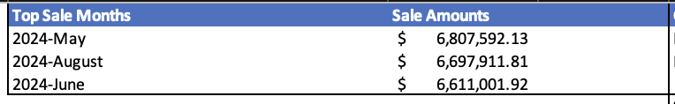
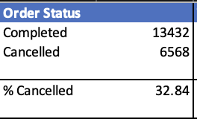
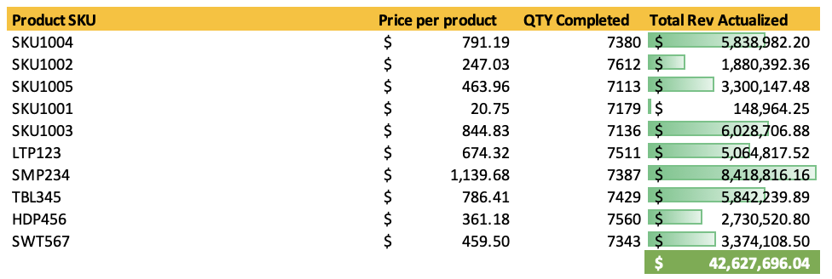
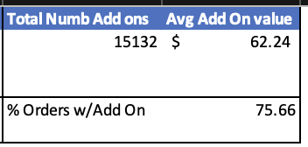
% of Cancelled Orders
Top Sales Months
Product SKU Performance
Add-On Values

Slide 4
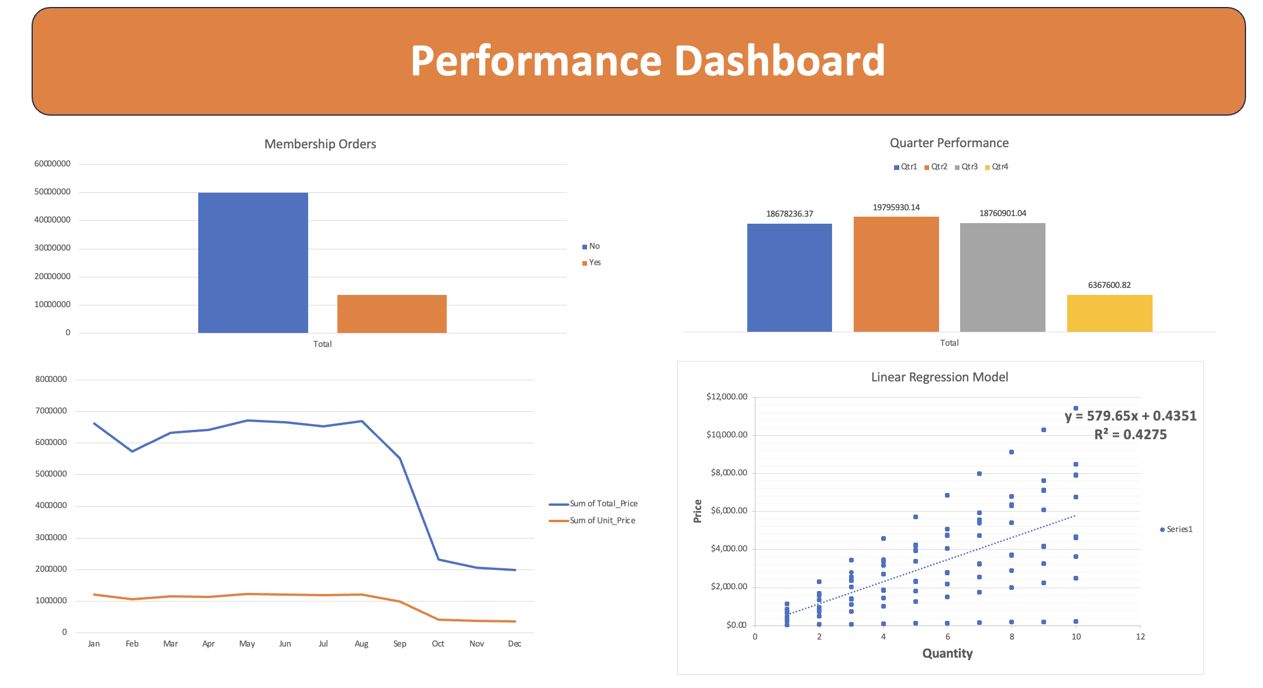
Additional Visualizations

Slide 5
Summary
This tech ecommerce business had its largest sales in May, August and June of 2024. Almost 33 % of online orders were cancelled, showing some strong order completion numbers. Product SKU SMP234 (smartphone) had the highest sale generation followed by SKU1003 (smartwatch). An astounding 75% of orders had add-ons with an average add-on value of $62.
Recommendations: Inventory of smartphones and smartwatches needs to remain high, especially in summer months. Continuing to offer add-ons at the end of orders can generate reliable revenue.

